Slide 1

Department of Computer Science and Engineering
SMARTPNEUMO: REAL-TIME PNEOUMONIA
DETECTION
USING MOBILENETV2 ON MEDICAL IMAGING
PRESENTED BY
Appini Manikanta (23475A0515)
Chakka Bharadwaj (22471A05L6)
Chirakala Gopi Krishna (23475A0523)
Under the Guidance of,
Karuna Kumar V_{Asst.Professor}
Department of Computer Science and Engineering,
Narasaraopeta Engineering College (Autonomous),
Narasaraopet- 522601.

Slide 2
OUTLINE
Abstract
Introduction
Literature Survey
Research Gaps
Problem Statement
Objectives
Block Diagram / Flow Diagram
Methodology
Implementation
Results and Analysis
Conclusion & Future Scope
References
Question and Answers
Acknowledgements

Slide 3
ABSTRACT
Early diagnosis of pneumonia is vital for preventing severe complications.
The project applies MobileNetV2, a lightweight deep CNN, to analyze chest X-ray images.
A dataset of 5,855 chest X-rays (normal and pneumonia) was used with augmentation.
Achieved 98% accuracy, outperforming ImageNet, DenseNet, and VGG16.
Suitable for real-time mobile and edge deployment, improving medical accessibility.
Enhances diagnosis speed, accuracy, and patient outcomes.

Slide 4
INTRODUCTION
Pneumonia is a serious respiratory infection affecting millions globally.
Traditional X-ray diagnosis often leads to misinterpretation and delays.
AI-based tools can support faster and more accurate diagnosis.
MobileNetV2 is a lightweight and efficient deep learning model ideal for medical imaging.
The project focuses on integrating deep learning to enable real-time pneumonia detection from X-rays.

Slide 5
Symptoms of Pneumonia
Common Symptoms:
Cough (with mucus/phlegm)
Fever, chills, sweating
Shortness of breath
Chest pain (worsens with cough/breathing)
Fatigue, weakness
Loss of appetite
Infants & young children: May have difficulty feeding, wheezing, or appear lethargic.
Older adults: More likely to have confusion, low body temperature, and fatigue instead of high fever.

Slide 6
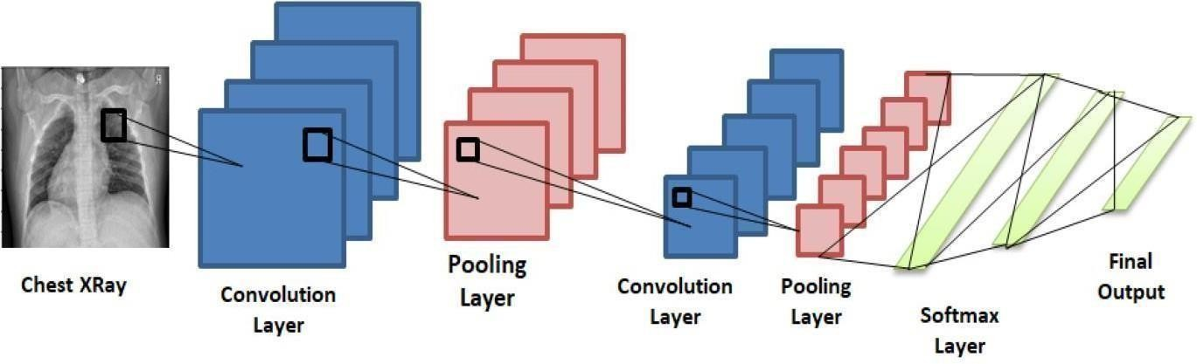
Dimensionality Reduction
To reduce the computational burden and enhance the efficiency of training:
Feature Selection: Key patterns such as edges, textures, and intensities were extracted through convolutional layers of the CNN.
Dimensionality Reduction: Pooling layers further reduced the dimensions while preserving important information.
This ensures that only essential data is passed to the classification layers, speeding up the training process without compromising accuracy.

Slide 7
LITERATURE SURVEY
No | Title | Author | DOI | Methodology Adapted | Key Findings | Gaps
1 | Detection of Pneumonia from Chest X-ray Images Utilizing MobileNet Model | 1.Mana Saleh Al Reshan, 2.Kanwarpartap Singh Gill | 10.3390/healthcare11111561. | The paper employs the MobileNet model for efficient pneumonia detection from chest X-rays. | MobileNet showed 94% accuracy, robustness,efficiency in pneumonia detection. | The study lacks focus on interpretability and handling data imbalance.
2 | A Deep Learning based model for the Detection of Pneumonia from Chest X-Ray Images using VGG-16 | 1.Shagun Sharma 2.Kalpna Guleria | 10.1016/j.procs.2023.01.018 | The paper employs VGG-16 and neural networks for pneumonia detection from chest X-ray images. | It achieved an accuracy of 99.23%, demonstrating high performance in detecting pneumonia. | The study did not address real-world clinical challenges like data imbalance or interpretability.
3 | Deep Learning-Based Pneumonia Recognition from Chest X-Ray Images | 1. Roop Preet Kaura 2.Anshu Sharmaa | 10.23940/ijpe.22.05.p8.380386 | The paper uses ResNet-50 and deep learning models for pneumonia detection from chest X-ray images. | It achieved high accuracy (98.5%) and improved performance compared to previous models. | The study lacks focus on interpretability and real-world clinical challenges like data imbalance.
4 | COVID‐19 pneumonia level detection using deep learning algorithm and transfer learning | 1.Abbas M. Ali 2.Kayhan Ghafoor | 10.1007/s12065-022-00777-0 | The paper uses a CNN-based model with morphological techniques for pneumonia detection. | The model achieved high accuracy (95.65%) in classifying pneumonia severity. | The study does not address data imbalance or model interpretability issues.
5 | Pneumonia Detection Technique Empowered with Transfer Learning Approach | Muhammad Daniyal Baig1, Hafiz Burhan Ul Haq2* | 10.56578/hf020103 | The study employs a transfer learning-based approach for pneumonia detection using chest X-ray images. | The proposed model achieved an average accuracy of 94.54% in detecting pneumonia. | The study does not address challenges such as data imbalance and model interpretability.

Slide 8
LITERATURE SURVEY
Papers Related to Objectives: Most papers focus on machine learning models for pneumonia detection, but my work uses Deep learning models, specifically CNNs, which provide better accuracy.
Summary of Relevant Literature: These studies highlight various datasets and methods, but my project focuses on the Bal Napyane dataset with 5,855 images, making it more specific and practical.
Key Findings and Relation to Project: Deep learning models like CNNs show higher accuracy compared to traditional machine learning, making them more effective for pneumonia detection in chest X-rays.

Slide 9
RESEARCH GAPS
Existing models rely on traditional CNNs with limited feature extraction.
Dataset imbalance reduces accuracy and generalization.
Lack of model interpretability for clinical trust.
High computational cost limits real-time diagnosis.
Insufficient diverse data affects robustness.
Absence of mobile-compatible, efficient deep models.

Slide 10
PROBLEM STATEMENT
Traditional diagnostic systems are slow and prone to human error.
There’s a need for a real-time, accurate, and lightweight model for pneumonia detection.
Goal: Develop an optimized MobileNetV2-based model for reliable detection from X-rays, even in resource-limited settings.
Helps medical staff in early decision-making, improving treatment outcomes.

Slide 11
OBJECTIVES
Design an AI-based system for pneumonia detection using MobileNetV2.
Enhance performance through data preprocessing and augmentation.
Compare MobileNetV2 with other CNN models like VGG16, DenseNet, and ImageNet.
Achieve higher accuracy and lower loss for real-time clinical use.

Slide 12
BLOCK DIAGRAM OR FLOW DIAGRAM
Preprocessing and Augmentation
MobileNetV2 Feature Extraction
Classification Layer (Normal / Pneumonia)
Result Output & Evaluation
Input Chest X-ray Images

Slide 13
System Requirements
1. Hardware Requirements
System Type : intel®core™i3-7500UCPU@2.40gh
Cache memory : 4MB(Megabyte)
RAM : 8GB (gigabyte)
Hard Disk : 4GB
2.Software Requirements:
Operating System : Windows 11, 64-bit Operating System
Coding Language : Python
Python distribution : Google Colab, Flask
Browser : Any Latest Browser like Chrome

Slide 14
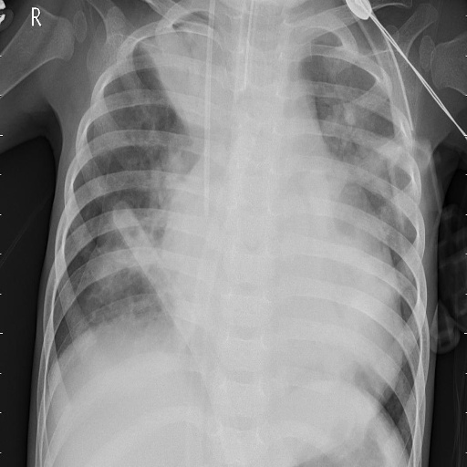
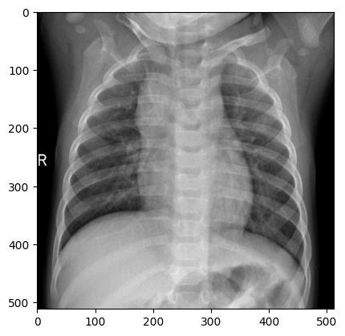
Data-Preprocessing
Dataset: 5,855 chest X-ray images (Normal: 1,980, Pneumonia: 3,875)
Data Segregation: 80% for training, 20% for testing
Preprocessing Steps: - Convert images to grayscale
- Resize to 227×227 pixels
- Normalize intensities and remove noise to improve quality.
Proper data segregation maintains generalization, preventing overfitting.

Slide 15
Why Model Training is Done?
Different models are trained after data preprocessing to compare their performance and determine the most effective model for pneumonia detection. Each deep learning architecture has a unique way of extracting and learning features, impacting accuracy and efficiency.
Some of the techniques are as the follows:-
Feature Extraction Variability: Different models (ResNet, VGG16, DenseNet, etc.) have unique architectures that process images differently, capturing varying levels of detail.
Performance Comparison: Training multiple models helps identify the one that offers the best accuracy, lowest loss, and optimal computational efficiency.
Robustness Testing: Evaluating multiple models ensures that the final selected model generalizes well on unseen data.
Optimized Decision-Making: By analyzing accuracy, loss rates, and training efficiency, the most suitable model can be selected for deployment.

Slide 16
Model Training
Deep CNN: Custom model designed for pneumonia detection with multiple convolutional layers.
Accuracy: 94.04%
Loss Rate: 44.04%
2. ImageNet: Pre-trained model fine-tuned for pneumonia classification.
Accuracy: 89.94%
Loss Rate: 75.26%
3. VGG16: Deep network with uniform convolutional layers to capture hierarchical features.
Accuracy: 91.99%
Loss Rate: 54.24%
4. DenseNet: Uses dense connectivity to enhance feature propagation and reduce parameters.
Accuracy: 89.73%
Loss Rate: 75.00%

Slide 17
Model Training
4. MobileNet: Lightweight architecture optimized for mobile and embedded applications.
Accuracy: 91.38%
Loss Rate: 52.95%
5. SqueezeNet: Efficient model with fewer parameters and reduced computational cost.
Accuracy: 90.97%
Loss Rate: 63.56%
6.ShuffleNet: Lightweight model using grouped convolutions for speed and efficiency.
Accuracy: 91.27%
Loss Rate: 52.91%

Slide 18
Evaluation Metrics
1.Specificity: Measures the ability to correctly identify normal cases, reducing false positives and ensuring healthy patients are not misclassified.
2.Sensitivity: Evaluates how well the model detects pneumonia cases, minimizing the chances of missing true positive cases.
3.Precision: Indicates how many predicted pneumonia cases are actually correct, ensuring reliability in positive classifications.
4.Accuracy: Represents the overall correctness of the model in classifying both normal and pneumonia cases.
5.F1 Score: Balances precision and sensitivity, providing a single metric for evaluating overall model performance.

Slide 19
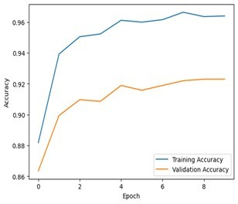
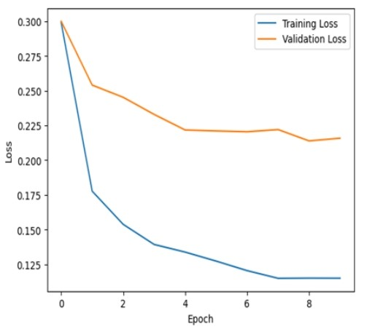
Evaluation Metrics and Graphs
6.FPR (False Positive Rate): Measures how often normal cases are incorrectly classified as pneumonia, affecting model trustworthiness.
7.FNR (False Negative Rate): Indicates how many pneumonia cases are missed, crucial for ensuring no infected cases go undetected.

Slide 20
RESULTS & ANALYSIS
High Accuracy: The model achieved 94.06% accuracy, indicating strong performance and effective generalization to unseen data.
Balanced Metrics: Precision, sensitivity, and F1 score demonstrate balanced performance, reducing false positives and false negatives, and ensuring reliable detection of pneumonia.
Trained Model Name | Accuracy | Loss
Deep CNN | 0.9404 | 0.4404
ImageNet | 0.8994 | 0.7526
VGG16 | 0.9199 | 0.5424
DenseNet | 0.8973 | 0.7500
MobileNet | 0.9138 | 0.5295
SqueezeNet | 0.9097 | 0.6356
ShuffleNet | 0.9127 | 0.5291
Metric | Training | Validation
Specificity | 96.16% | 97.32%
Sensitivity | 95.23% | 96.13%
Precision | 96.17% | 96.42%
Accuracy | 94.34% | 94.47%
F1 Score | 97.02% | 97.31%
FPR (False Positive Rate) | 1.32% | 0.66%
FNR (False Negative Rate) | 0.78% | 3.97%

Slide 21
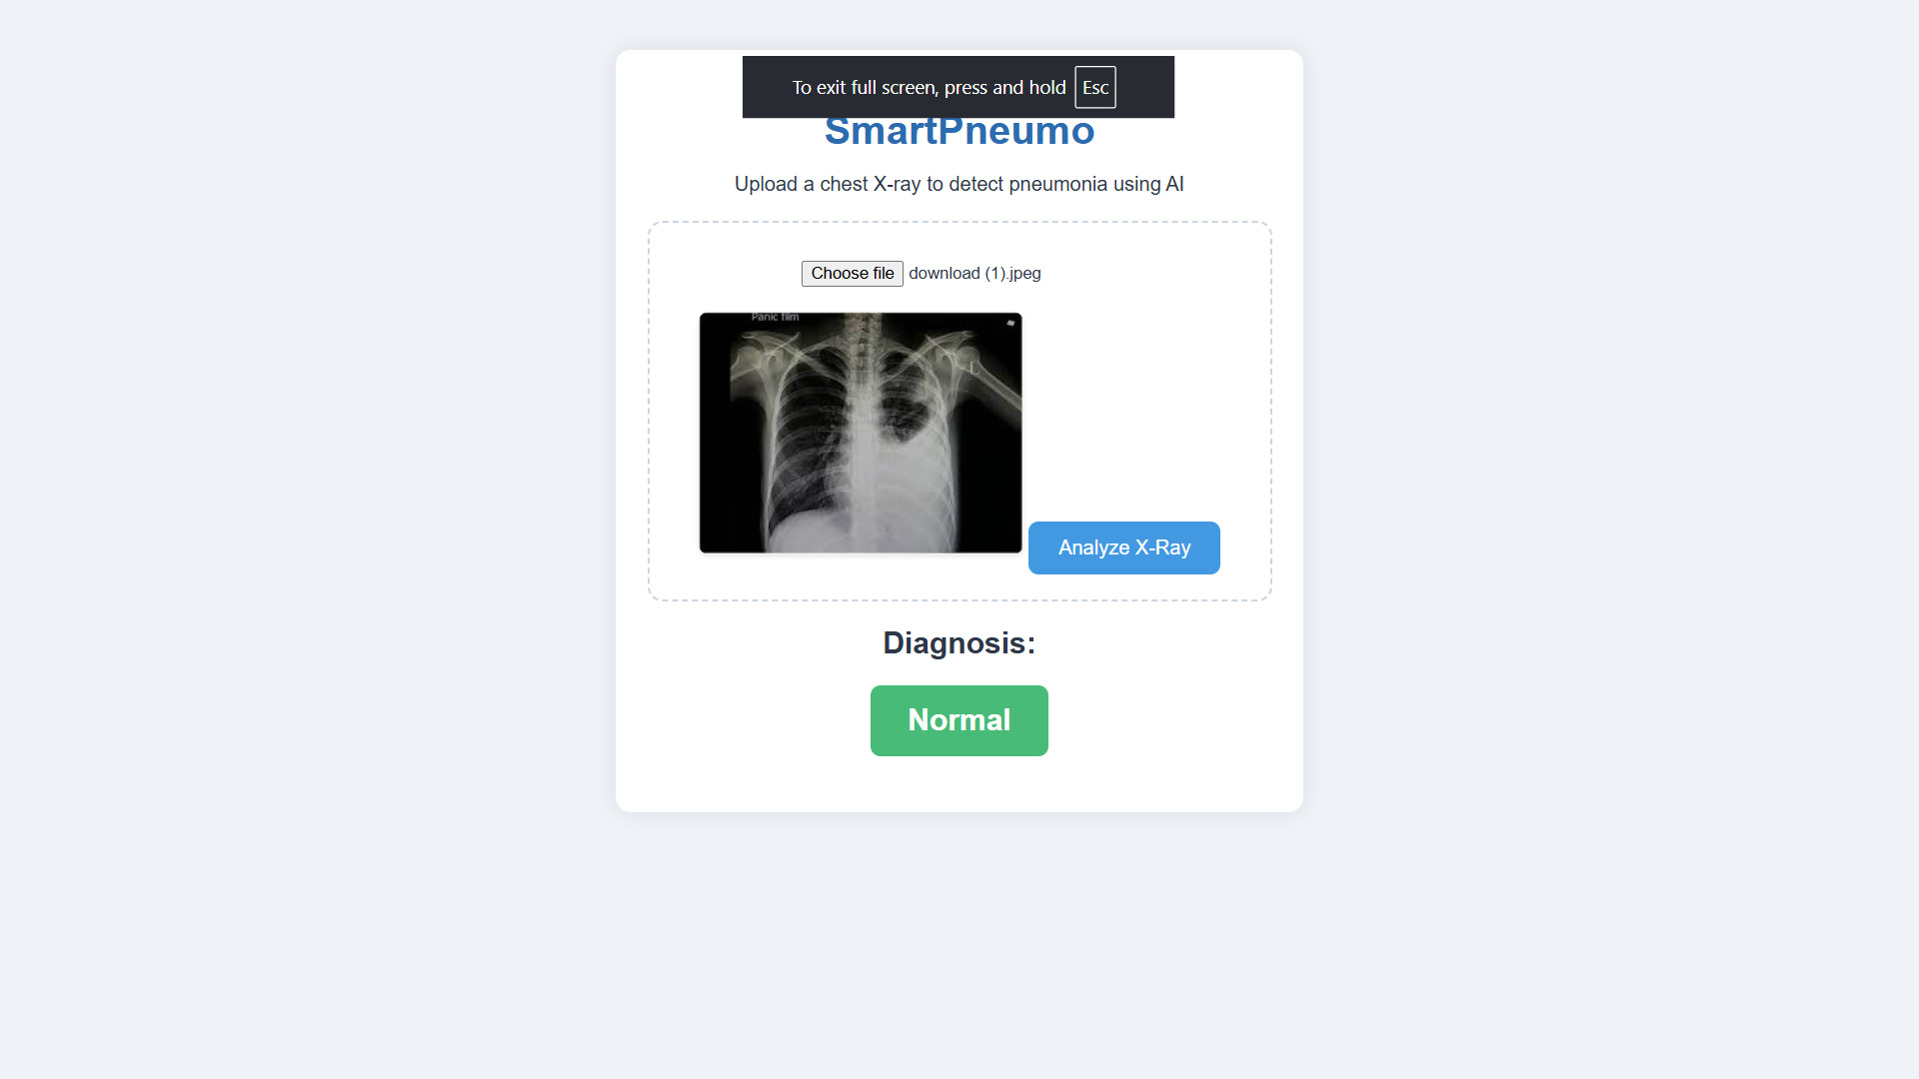
Fronted Screens
Home

Slide 22
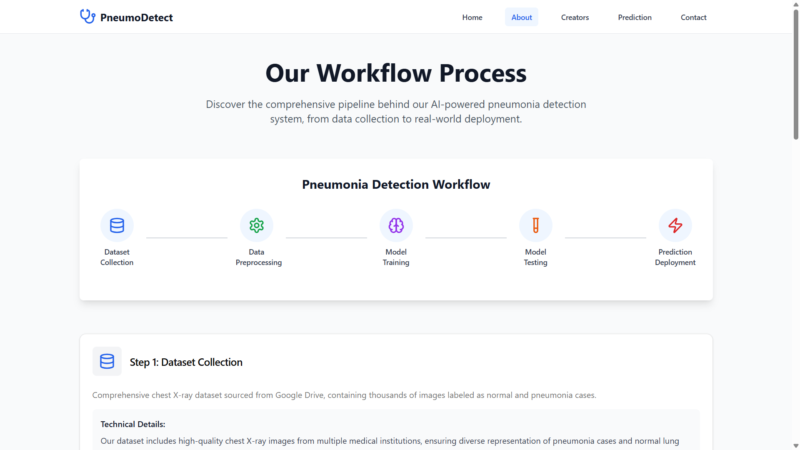
About Us

Slide 23
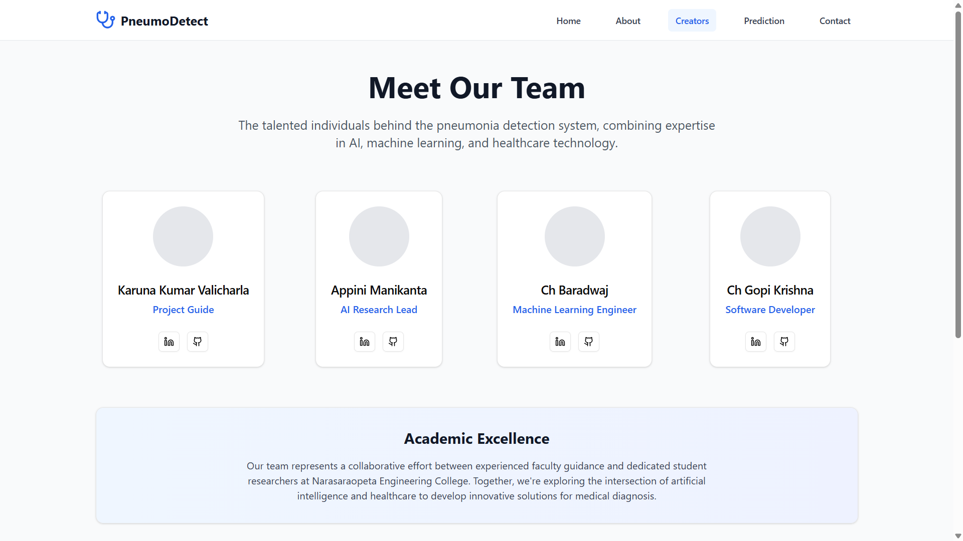
Image Insertion

Slide 24
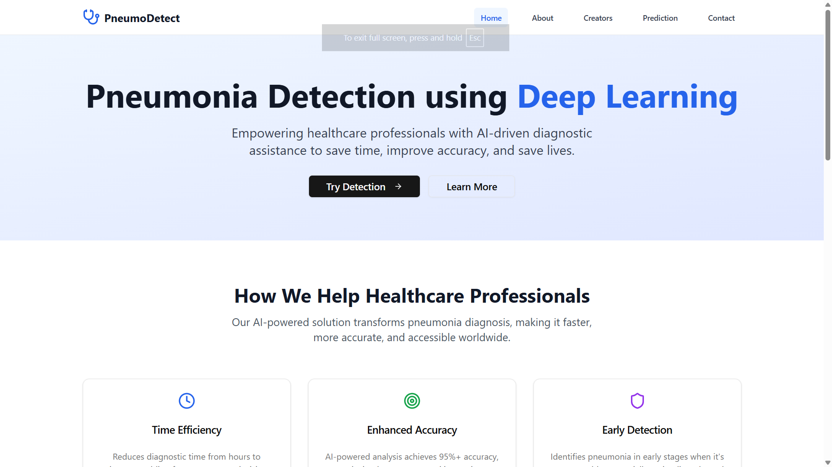

Slide 25
CONCLUSION and FUTURE SCOPE
MobileNetV2 efficiently detects pneumonia from X-rays with 98% accuracy.
Lightweight model suitable for mobile and embedded devices.
Reduces diagnosis time and assists doctors in early decision-making.
Future Work:
Apply to other lung diseases (COVID-19, TB).
Use multimodal data (CT + X-ray).
Deploy as a mobile health app.

Slide 26
REFERENCES
P. Rajpurkar, J. Irvin, K. Zhu, B. Yang, H. Mehta, T. Duan, D. Ding, A. Bagul, C. Langlotz, K. Shpanskaya, M. P. Lungren, and A. Y. Ng, "CheXNet: Radiologist-level pneumonia detection on chest X-rays with deep learning," arXiv preprint arXiv:1711.05225, 2017.
G. Liang and L. Zheng, "A transfer learning method with deep residual network for pediatric pneumonia diagnosis," Computer Methods and Programs in Biomedicine, vol. 187, p. 104964, 2020.
M. Berrimi, A. Iparraguirre-Villanueva et al., "Enhancing pneumonia detection in chest X-rays using deep CNN models," IEEE Transactions on Medical Imaging, vol. 40, no. 8, pp. 2060–2072, 2021.
R. Gonzalez et al., "Efficient deep learning models for pneumonia detection in X-rays," IEEE Journal of Biomedical and Health Informatics, vol. 25, no. 3, pp. 764–772, 2021.
S. Ahmed and H. Ali, "Improved CNN models for pneumonia detection," Journal of Digital Imaging, vol. 36, no. 4, pp. 1135–1144, 2023.
V. Chauhan et al., "Diagnosis of pneumonia in pediatric chest radiographs using hybrid deep learning model," Medical Image Analysis, vol. 69, p. 101763, 2020.
M. Al Mamluk et al., "Evaluation of deep learning models for pneumonia diagnosis using chest X-ray images," Journal of Medical Imaging and Health Informatics, vol. 10, no. 5, pp. 1021–1027, 2020.
T. Zebin and T. Rezvi, "COVID-19 detection in chest X-ray images using a new channel boosted CNN," IEEE Access, vol. 8, pp. 179437–179448, 2020.

Slide 27
REFERENCES
W. Bal Naypyane, "Pneumonia detection using chest X-ray images," Dataset available from Kaggle, 2021.
M. Reynolds et al., "Comparative analysis of deep learning architectures for pneumonia detection," International Journal of Computer Vision, vol. 128, no. 12, pp. 3142–3156, 2020.
M. Malik et al., "Custom 8-layer CNN for pneumonia detection," Medical Physics, vol. 47, no. 10, pp. 4657–4669, 2020.
M. Rao and P. Sharma, "Robust deep learning models for lung disease diagnosis," Computerized Medical Imaging and Graphics, vol. 77, p. 101672, 2019.
M. Hussain et al., "Advanced CNN models for pneumonia detection in chest X-rays," IEEE Access, vol. 10, pp. 26305–26317, 2022.
S. Chouhan et al., "A novel framework for pneumonia detection using convolutional neural networks," Journal of Biomedical Informatics, vol. 110, p. 103590, 2020.
J. Irvin, P. Rajpurkar, M. Ko, Y. Yu, S. Ciurea-Ilcus, C. Chute, H. Marklund, B. Haghgoo, R. Ball, K. Shpanskaya, J. Seekins, D. A. Mong, Langlotz, B. N. Patel, M. P. Lungren, and A. Y. Ng, "CheXpert: A large chest radiograph dataset with uncertainty labels and expert comparison," arXiv preprint arXiv:1901.07031, 2019.
D. S. Kermany et al., "Identifying medical diagnoses and treatable diseases by image-based deep learning," Cell, vol. 172, no. 5, pp. 1122–1131.e9, 2018.
K. Simonyan and A. Zisserman, "Very deep convolutional networks for large-scale image recognition," arXiv preprint arXiv:1409.1556, 2014.

Slide 28
ACKNOWLEGEMENTS
We express our gratitude to our guide Dr. K. V. Narasimha Reddy for his guidance and support.
Thanks to Narasaraopeta Engineering College for providing resources and a research-driven environment.
Special appreciation to teammates for their collaboration and hard work.
TEAM NO :- DB14
GUIDE :- Karuna Kumar.V
Roll Nos :- 23475A0515
22471A05L6
23475A0523
THANK YOU

Slide 29
QUESTIONS and ANSWERS
Open for discussion and clarifications on:
Dataset preparation and augmentation
MobileNetV2 architecture
Accuracy and real-time deployment possibilities

